Slide 1

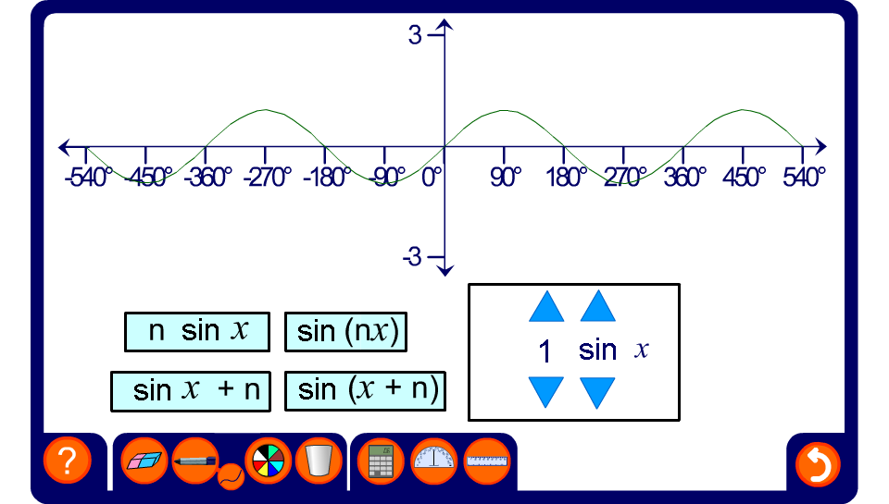


Transforming trigonometric graphs
Notes:
Use this activity to explore transformations of sine, cosine and tangent graphs.
Transformations of functions is covered in more detail in A9 Graphs of non-linear functions.
The input is x here rather than θ to be consistent with general function notation.

